Slide 1
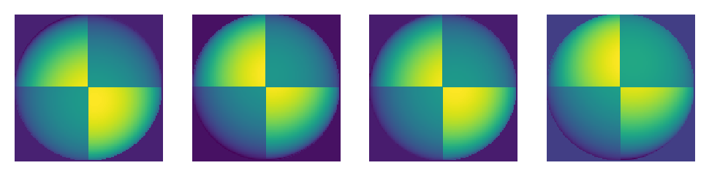
APPLIED PHYSICS 187
DR. MARICOR SORIANO
Activity 13
PHOTOMETRIC STEREO
Figure 1.Synthetic images at a different point source location [1].
RENE L. PRINCIPE JR.
2015-04622

Slide 2
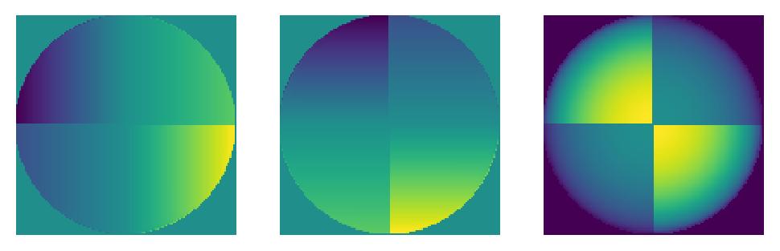
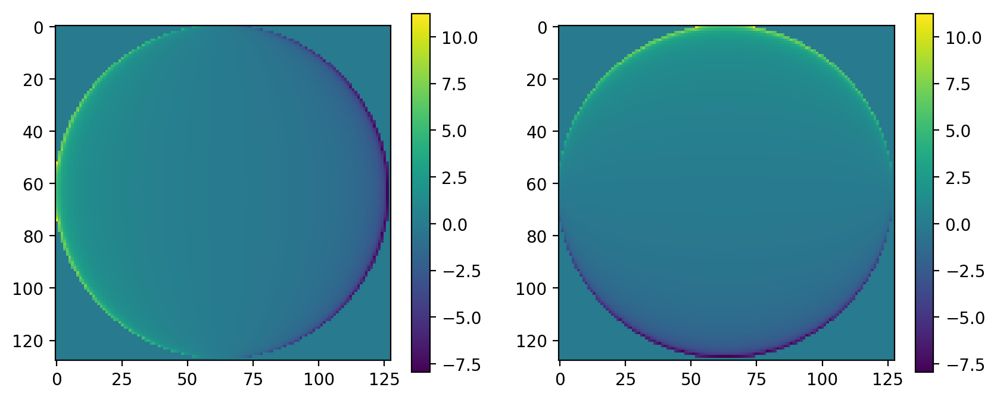
In this activity, a 3D reconstruction technique is implemented using images of the object with 4 different point source locations as shown in Fig, 1. We are literally generating the shape from the shadows casted by point source. By multiplying the source vector and the images and getting its normal, a surface normal matrix can be generated as shown in Fig. 2 [1].
Figure 2. Surface normals n (nx ny nz) calculated using photometric stereo
Once the surface normals are calculated, the partial derivatives of the surface is related to- nx/nz and –ny/nz respectively and they are shown in Fig. 3. To reconstruct the surface, a line integration shall be evaluated.
Figure 3. Partial derivative plot of the surface along x and y respectively.

Slide 3
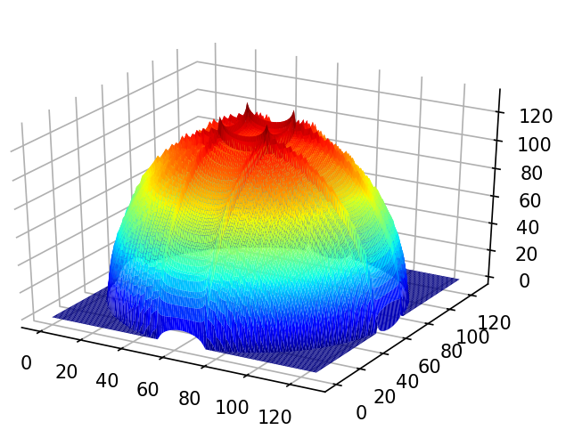
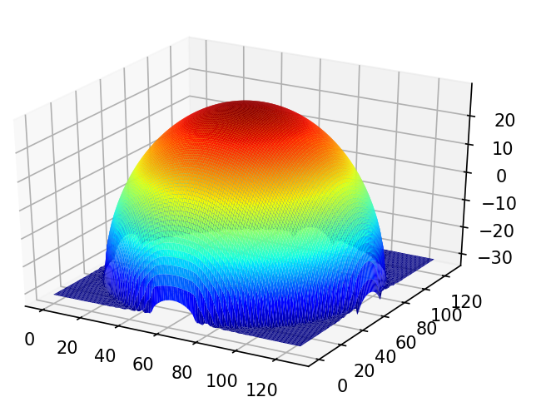
Figure 4. A simple cumulative sum operation instead of line integral can almost represent the 3D surface oaf our object as shown on the left image. A more comprehensive line integral calculation using Frankot-Chellappa algorithm results to a smoother hemisphere reconstruction as shown on the right, [2].
Two ways were used to evaluate the integral, one is exploiting its analogy to summation and the other is using an algorithm which used Fourier Transforms [2]. Both results were shown in Fig. 4. Using 2D images, a 3D image was reconstructed by the shadows casted on different point source location.
I’d like to thank Kenneth Domingo for helping me implement the Frankot-Chellappa algorithm.
References:
[1] Soriano, M. (2019). Photometric stereo.
[2] Frankot, R. T., & Chellappa, R. (1988). A method for enforcing integrability in shape from shading algorithms. IEEE Transactions on pattern analysis and machine intelligence, 10(4), 439451.

